Slide 1
Design And Development Of A Web Application For Group Study
Name: Md.AL Mamun
ID:1710676107
Session:2016-17
Course code: CSE 4292
Dept. of Computer Science & Engg.

Slide 2
Objective
Online group study
Create group or join existing group
Select topics and chapter
Select exam schedule
Creating question (Every group member)
Exam start at fixed time
Result

Slide 3
Required Front-End Tools
HTML 5
CSS 3
Jquery
JavaScript
Bootstrap 5.0
Font Awesome

Slide 4
Required Back-End Tools
Server site language PHP
PHP framework Laravel 8.x
MySQL
Livewire (full-stack framework for Laravel
Sweet Alert

Slide 5
Software Tools
Operating System: Windows 10
Web server: Apache 2.4.23
Text editor: Visual Studio Code

Slide 6
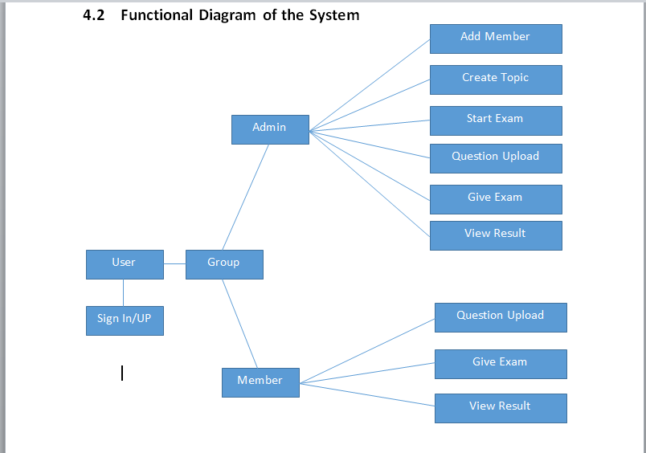
Background Study

Slide 7
Database Design
.
Users
Topics
Groups
(admin)
Options
Questions
Group Members
Exams
Answers

Slide 8
How does MVC Framework Works?
Controller
Send Data
Response Inf.
Request Inf.
View
Model
Request
Database
Users
Collect Data
Response

Slide 9
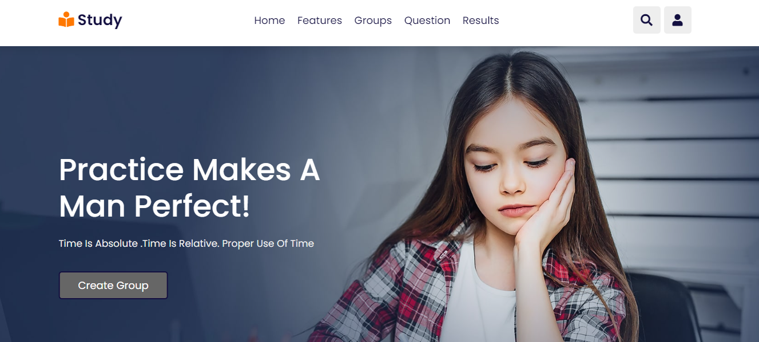
Home Page view of Group Study

Slide 10
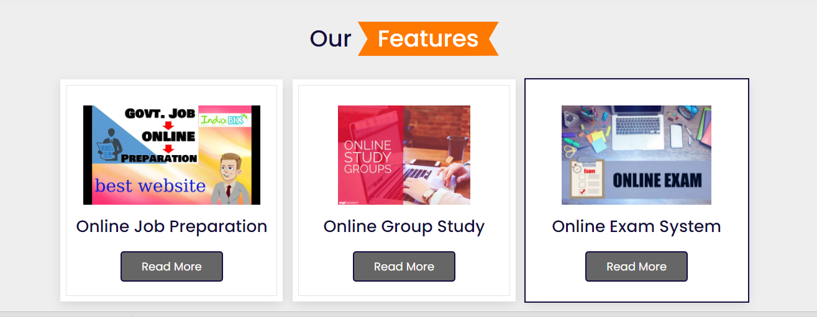
Home Page view Cont…

Slide 11
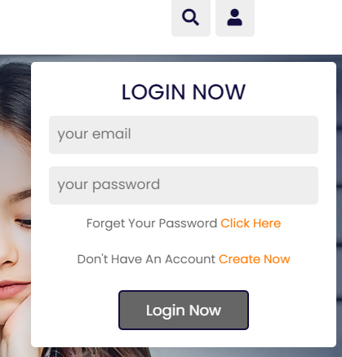
User Login page

Slide 12
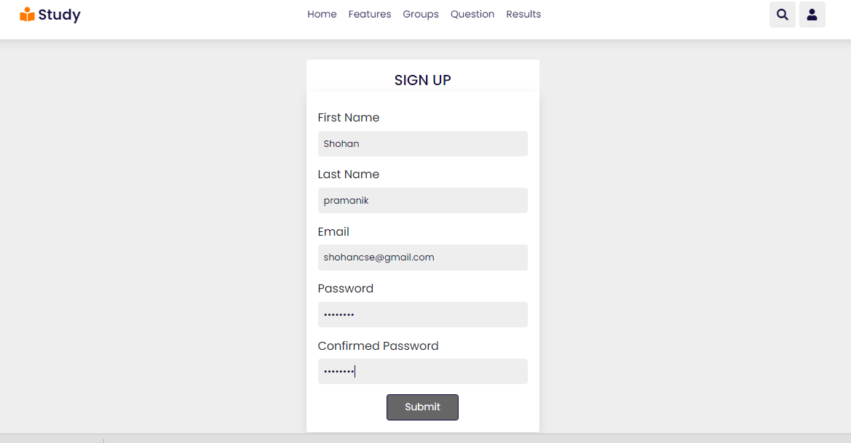
User Sign Up Page

Slide 13
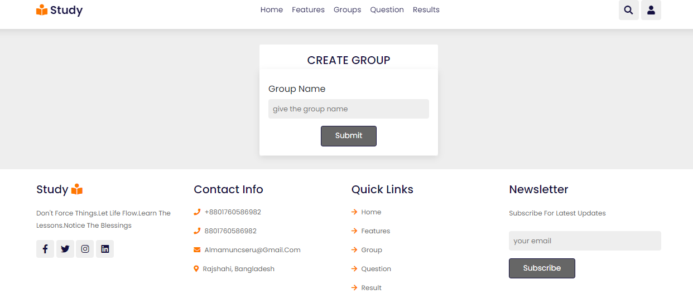
Create New Group

Slide 14
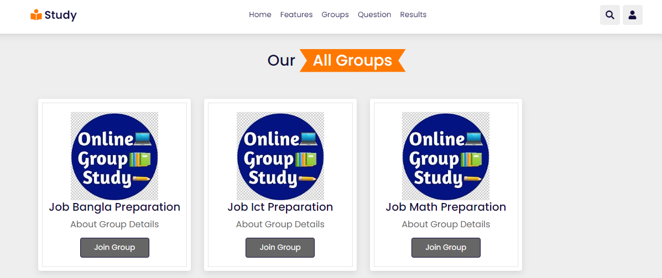
Or Request to Join Existing Group

Slide 15
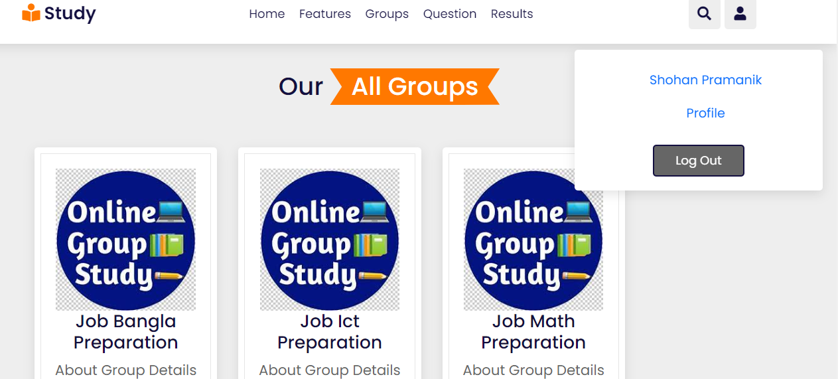
User Profile Page

Slide 16
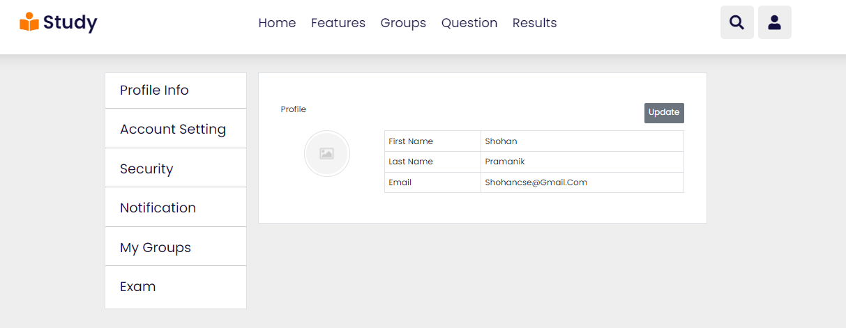
Profile Page Cont…

Slide 17
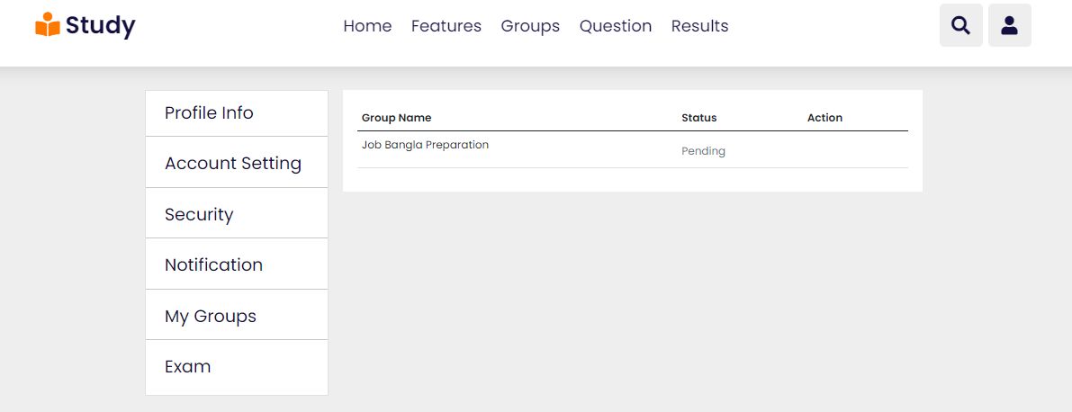
My Groups
The join Request are pending

Slide 18
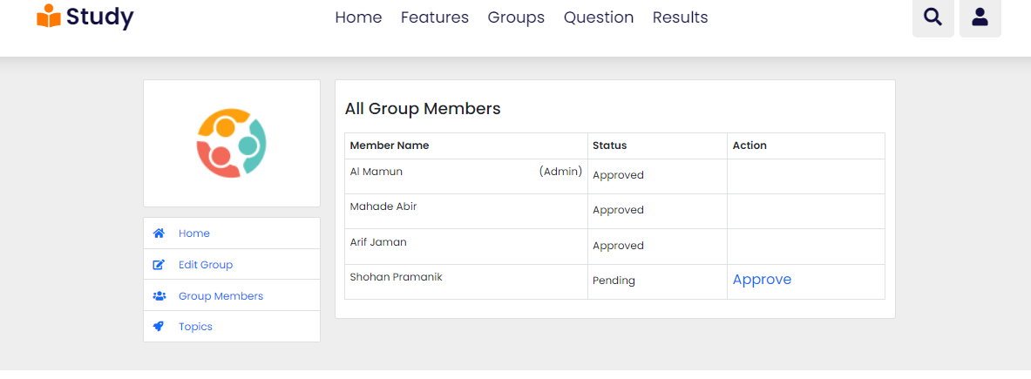
Admin of The Group

Slide 19
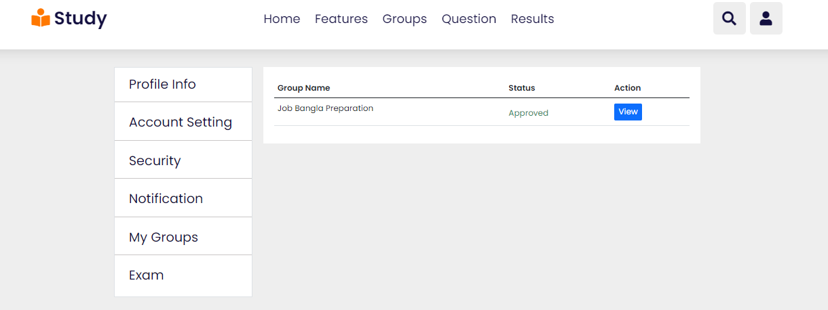
After Approved

Slide 20
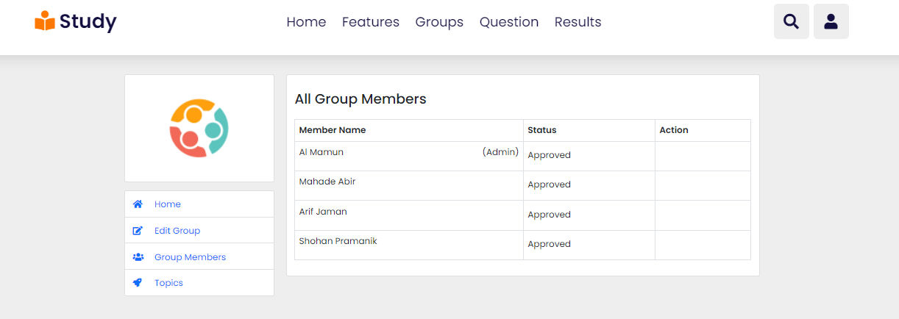
All Group Members

Slide 21
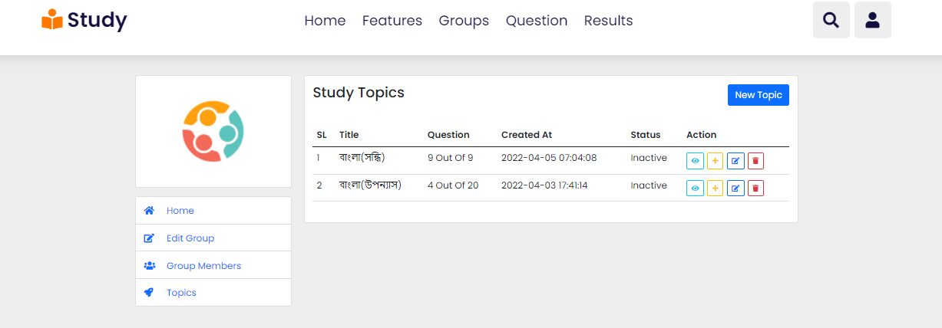
Topics

Slide 22
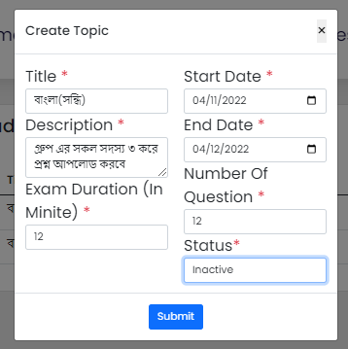
Only Admin can add new Topic

Slide 23
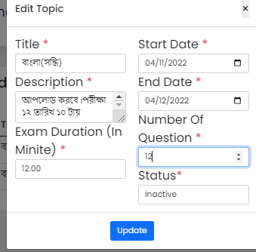
Update Topic

Slide 24
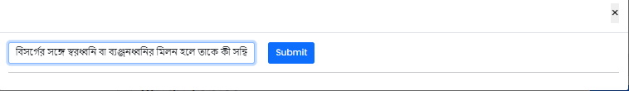
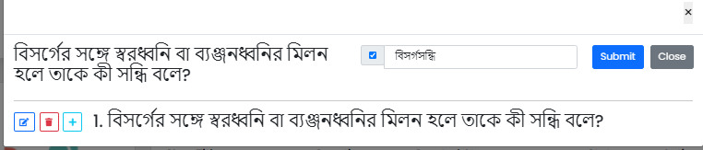
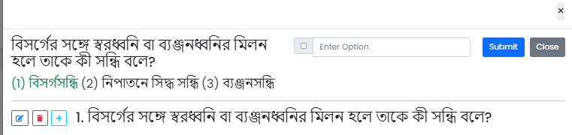
Questions upload

Slide 25
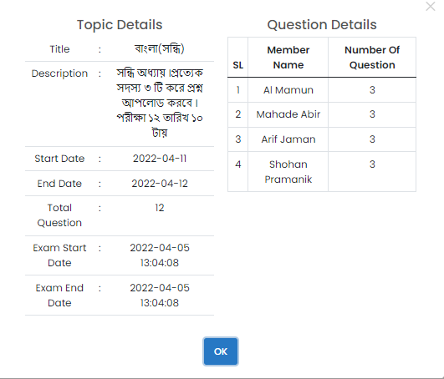
Topics Details

Slide 26
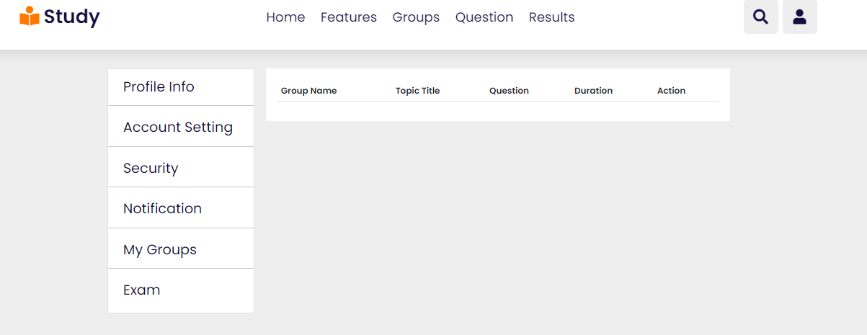
Exam will not start until Admin active status

Slide 27
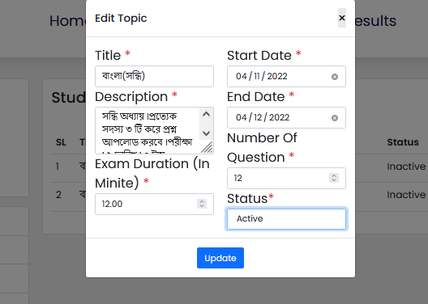
Admin active status

Slide 28
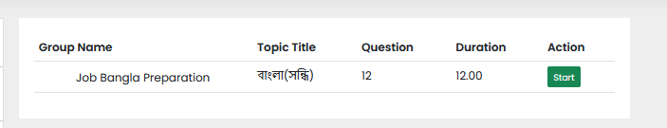
Now Exam Started

Slide 29
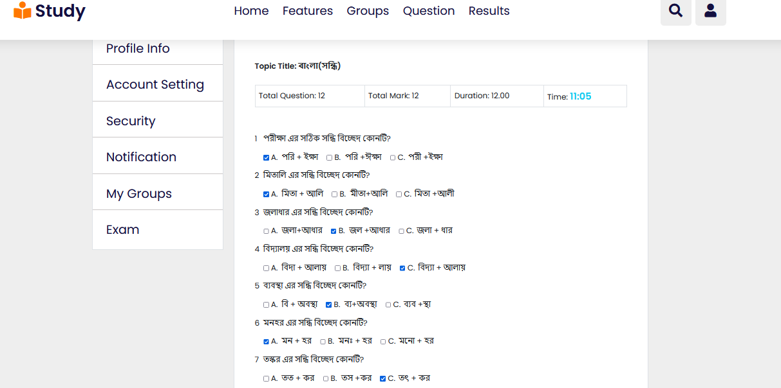
Given Exam

Slide 30
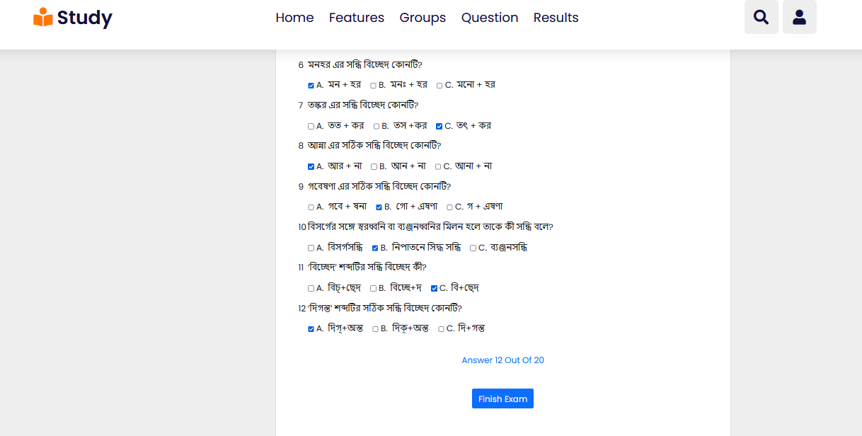
Exam Cont…

Slide 31
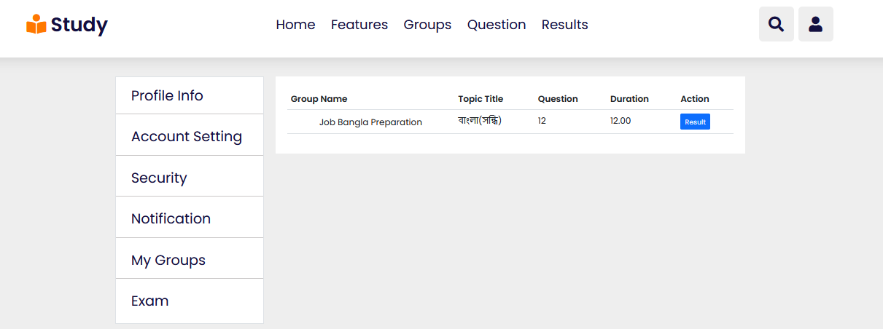
Result Show

Slide 32
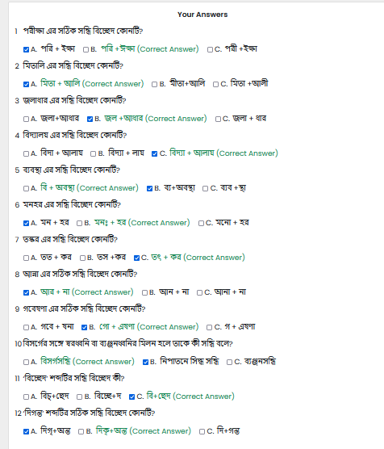
Correct and Wrong ans:

Slide 33
Thank You
?

